Slide 1



MetroCredit Bank
Information System Audit
[Audit Group #3]
COLLIN COLLEGE · CYBR 4340
Under the Guidance of:
PROFESSOR AKANNI GBOLAHAN

Slide 2

Team Roles
OM PRAKASH – PROJECT LEAD / COORDINATOR
KENDALL WALLS – RESEARCH LEAD
SHAKERA SUBEDAR – COMPLIANCE ANALYST
YAFA ADIDA – TECHNICAL ANALYST
PHIL MAHUWE – RISK ANALYST
AHAD NIZUM – PRESENTATION LEAD
VICTOR TEINERT – REPORT WRITER / EDITOR

Slide 3

INTRODUCTION
AUDIT SCOPE
METHODOLOGY
GRC FRAMEWORK
FINDINGS (COMPLIANCE & TECHNICAL)
RISK ASSESSMENT
RECOMMENDATIONS
REMEDIATION ROADMAP
CONCLUSION
REFERENCES

Slide 4

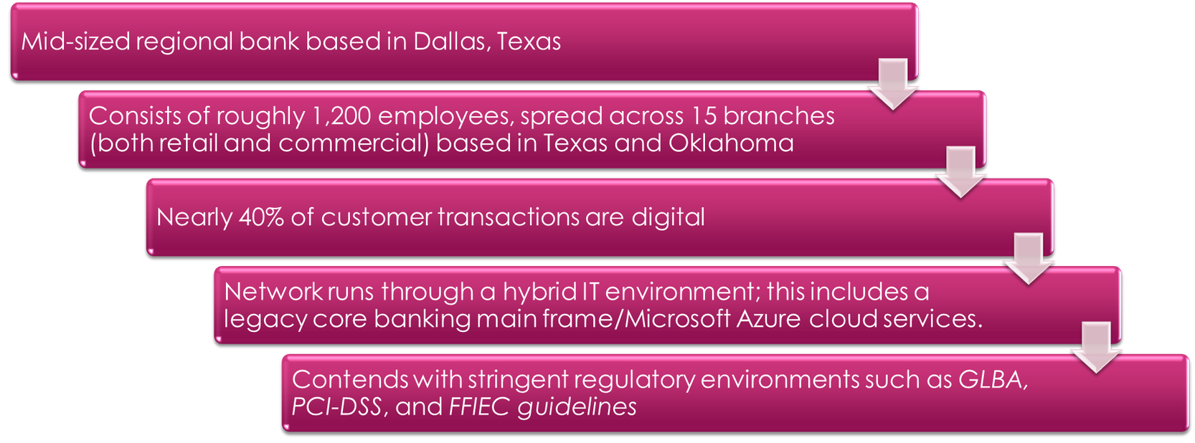

Slide 5

SYSTEMS
Core Banking Mainframe
Azure Cloud
IAM / Active Directory
IR / DR Systems
PROCESSES
Access Governance
Vendor Management
Policy Enforcement
Awareness Training
STANDARDS USED
GLBA · PCI-DSS v4.0 · FFIEC · NIST CSF · ISACA ITAF

Slide 6
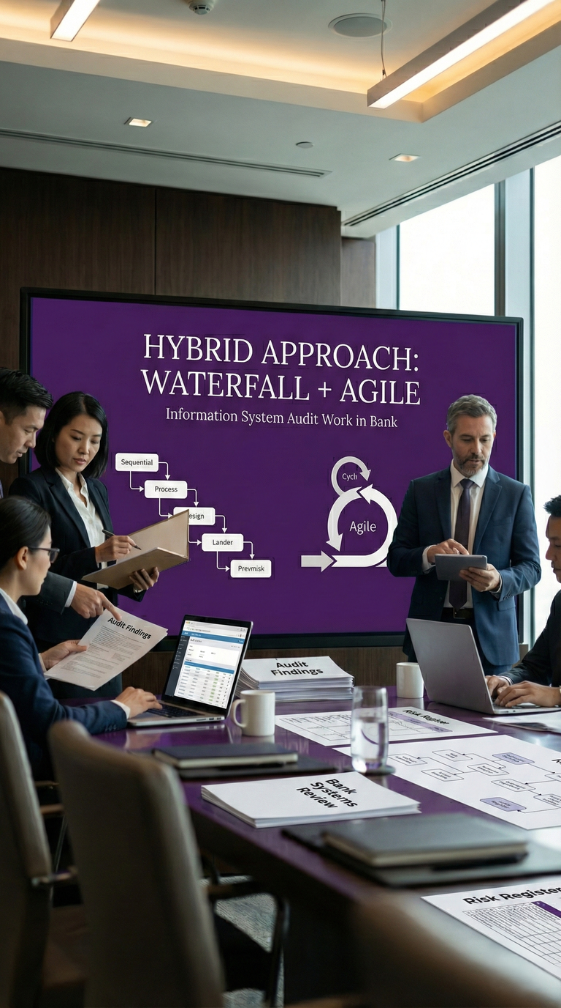
Methodology
Hybrid approach: Waterfall + Agile
Weekly team check-ins
ISACA risk-based audit framework
NIST CSF & 800-53 control mapping
Evidence-based validation

Slide 7
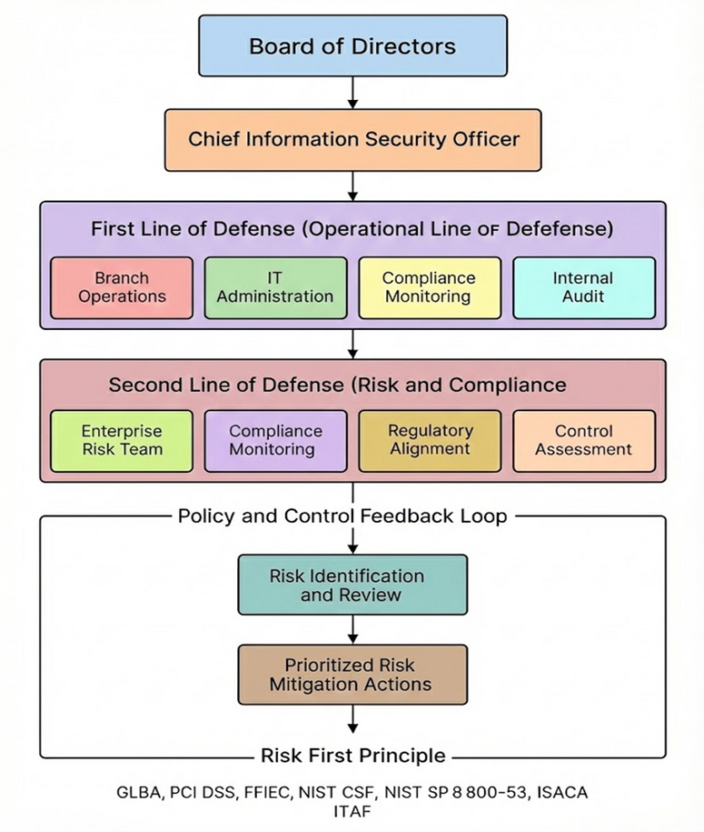
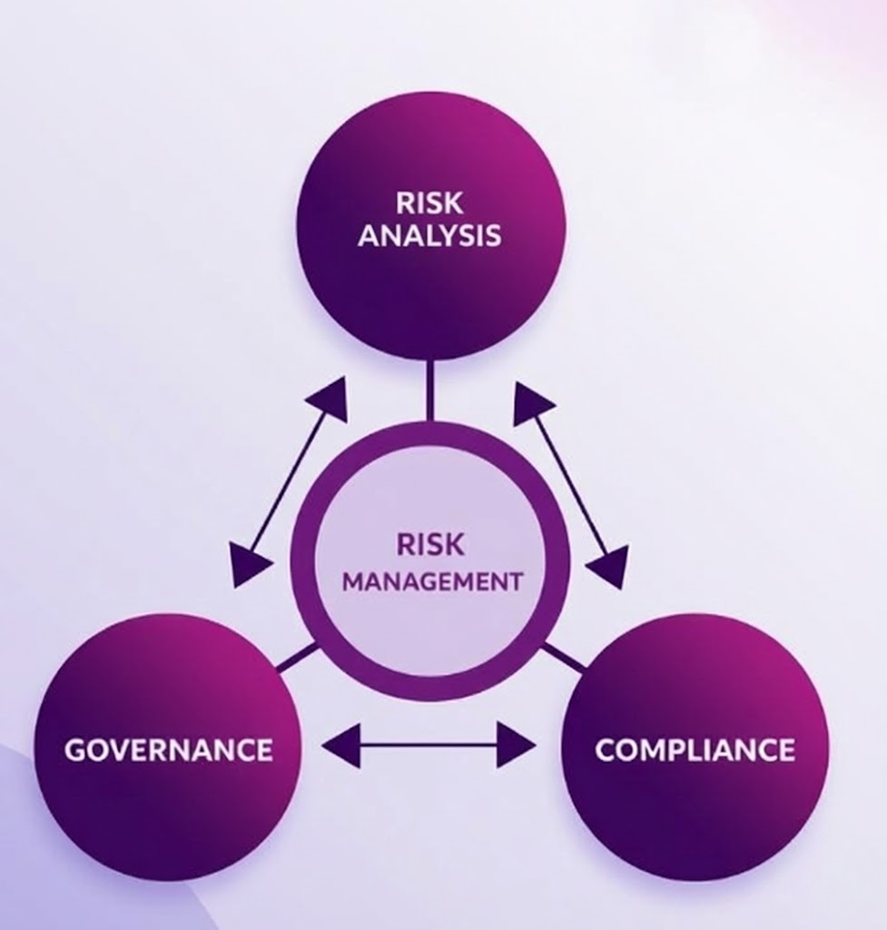
GRC Framework Overview

Slide 8
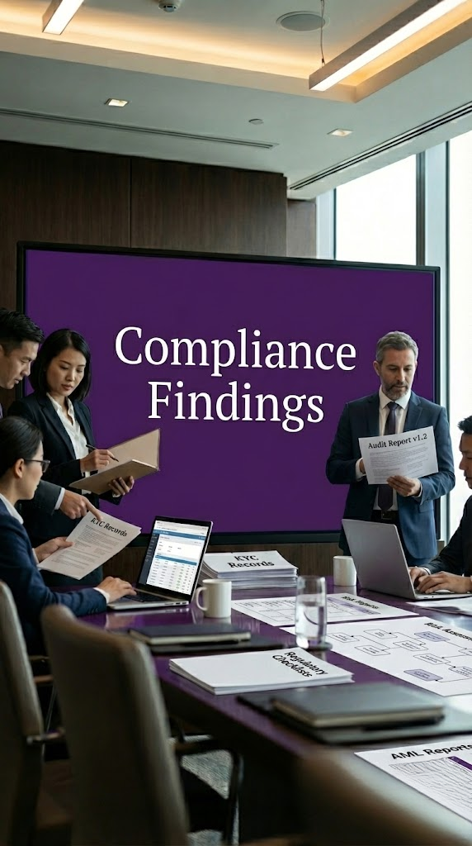
MFA not fully implemented
Shared admin accounts
Vendor assessments incomplete
Missing SOC 2 reviews
EISP inconsistently enforced

Slide 9

Technical Analysis
Outdated patching on legacy systems
Weak IAM controls and credential reuse
Azure logging inconsistent
Flat network segmentation
Outdated IR plan
DR not tested

Slide 10

Main Challenges
Partial MFA rollout
Shared administrative credentials
Vendor oversight gaps
Legacy infrastructure
High phishing failure rate
Weak awareness program

Slide 11
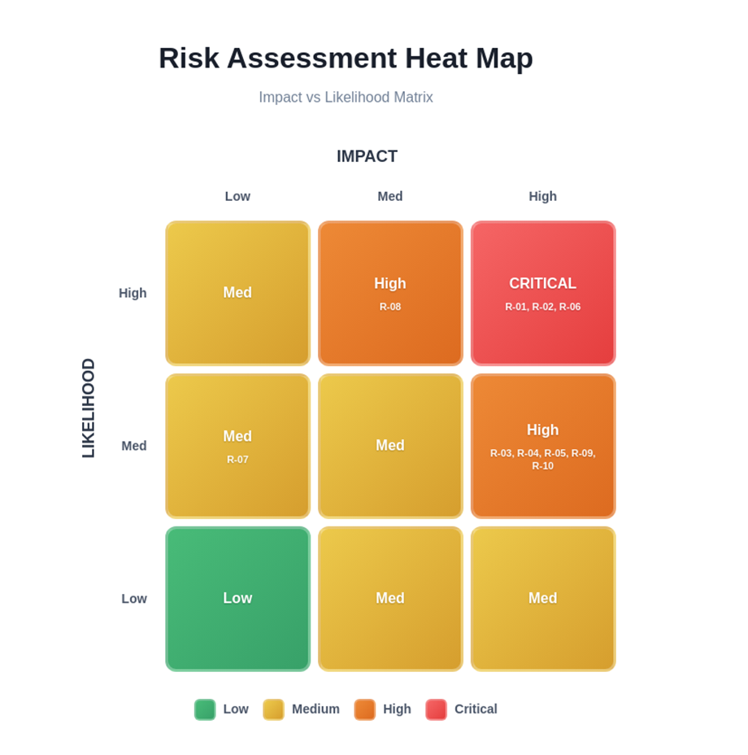
Risk Assessment Overview
Risk Distribution:
3 Critical
6 High
1 Medium

Slide 12
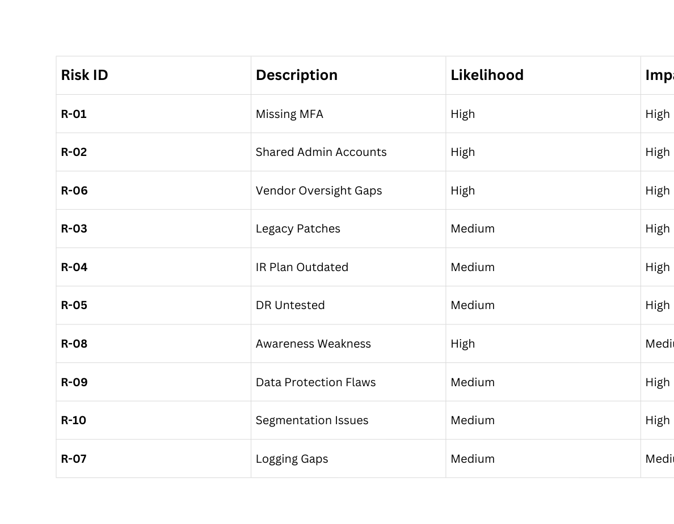
Risk Matrix Table

Slide 13
Audit Findings
COMPLIANCE FINDINGS
The audit revealed several key compliance issues, indicating non-adherence to regulations. Immediate corrective actions are necessary to mitigate risks and ensure alignment with industry standards.
TECHNICAL FINDINGS
A thorough examination of the systems uncovered critical vulnerabilities in infrastructure. Addressing these weaknesses is vital for safeguarding sensitive data and maintaining operational integrity.
RISK FINDINGS
The assessment identified multiple high-risk areas, including potential data breaches and insider threats. Ongoing monitoring and proactive measures are essential to protect the bank's resources effectively.

Slide 14
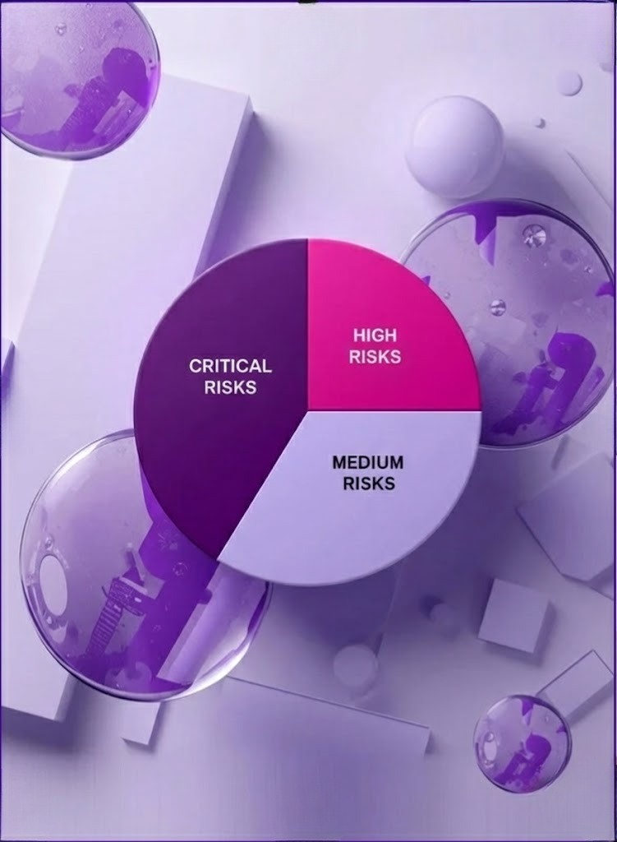
45%
Percentage of Critical Risks
This figure indicates that 45% of the identified risks fall into the critical category, highlighting urgent areas for attention and remediation to ensure compliance and security.

Slide 15

Recommendations
Enforce full MFA and implement PAM
Modernize legacy systems
Strengthen vendor oversight
Update IR/DR plans and test annually
Improve logging through SIEM integration
Enhance security awareness training

Slide 16
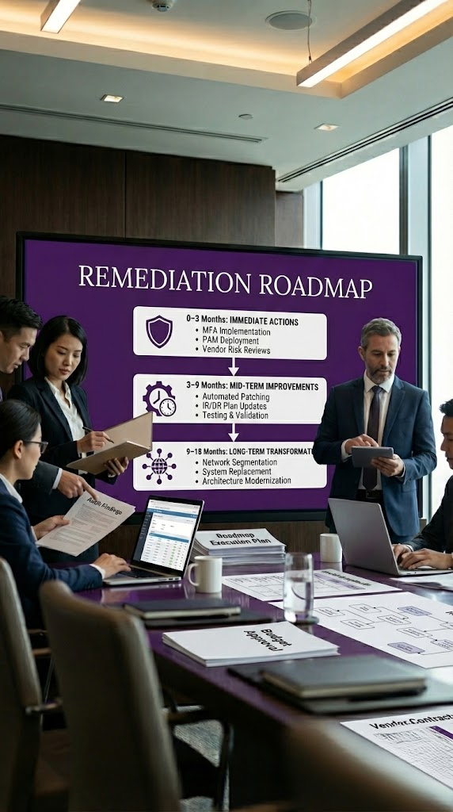
Remediation Roadmap
0–3 Months: MFA, PAM, vendor reviews
3–9 Months: Patching, IR/DR updates
9–18 Months: Network segmentation, system replacement

Slide 17

References
1. National Institute of Standards and Technology. (2018). Framework for improving critical infrastructure cybersecurity (Version 1.1). U.S. Department of Commerce. https://nvlpubs.nist.gov/nistpubs/cswp/nist.cswp.04162018.pdf ​
2. National Institute of Standards and Technology. (2020). Security and privacy controls for information systems and organizations (NIST SP 800-53 Rev. 5). U.S. Department of Commerce. https://doi.org/10.6028/NIST.SP.800-53r5 ​
3. PCI Security Standards Council. (2022). Payment card industry data security standard: Requirements and testing procedures (Version 4.0). PCI SSC. https://www.pcisecuritystandards.org/document_library ​
4. Federal Financial Institutions Examination Council. (2021). FFIEC IT examination handbook: Information security booklet. FFIEC. https://ithandbook.ffiec.gov/it-booklets/information-security.aspx ​
5. Gramm-Leach-Bliley Act, Pub. L. No. 106-102, 113 Stat. 1338 (1999). https://www.govinfo.gov/content/pkg/PLAW-106publ102/pdf/PLAW-106publ102.pdf

